Slide 1
Sprocket Central Pty Ltd
Identify which of the 1000 customers Sprocket Central Pty Ltd should target.

Slide 2
Problem
Problem1: Datasets provided by Sprocket Central Pty Ltd. We have to identify all data quality issues. Dataset have four sheets "Customer Demographic", "Customer Address", "Transactions" and "New Customer List" Once we've had a look at these datasets, draft an email to the client identifying all data quality issues.
Problem2: Create a PowerPoint presentation which outlines the approach we will be taking to identify which of the 1000 customers Sprocket Central Pty Ltd should target, based on the dataset. Explain the three phases: Data Exploration; Model Development and Interpretation.
Problem3: Develop a dashboard that we can present to the client at our next meeting. Display your data summary and results of the analysis in a dashboard (see tools/references for assistance). Specifically, your presentation should specify who Sprocket Central Pty Ltd' should be targeting out of the new 1000 customer list.

Slide 3
Tasks
Problem1: Data quality issue
Analyse statistics summary from the datasets.
Found outliers, reoccurrence of data and empty values in certain records.
Found Inconsistent values for the same attribute.
Problem2: Data Exploration, Model Development and Interpretation
Customer Analysis
Customers Age distribution
Job Industry category analysis
Top bike model analysis
Bike purchases last 3 years analysis
Job Industry category analysis
Top targeted customer
Problem3: Dashboards
Purchase trends of customer
Profit Insight
Customer segment

Slide 4
Problem 1 Solution

Slide 5
Data Quality issue Solution
Table Name | No. of records | Distinct Customer IDs
Customer Demographic | 3912 | 3912
Customer Address | 3999 | 3999
Transaction Data | 20000 | 19640
New Customer list | 1000 | 1000
Various columns, such as the brand of a purchase, or job title, have empty values in certain records
Inconsistent values for the same attribute
e.g. -> Victoria being represented as “V”, “Vic”
and “Victoria”
-> Male being represented as “M”
-> Female being represented as “F”
Mitigation: Use regular expression to replaced extended values into abbreviations to ensure consistency across addresses.
Inconsistent data type for the same attribute
e.g. -> Change the date type to date format
-> Currency in currency format
-> Numbers in number format
For key datasets, such as transactions, less than 1% of transactions (totalling less than 0.1% of revenue) have missing fields. These records have been removed from the training dataset.
Some Customer’s age showing more that 120 years may be it outliers so filter the data.

Slide 6
Problem 2 Solution

Slide 7
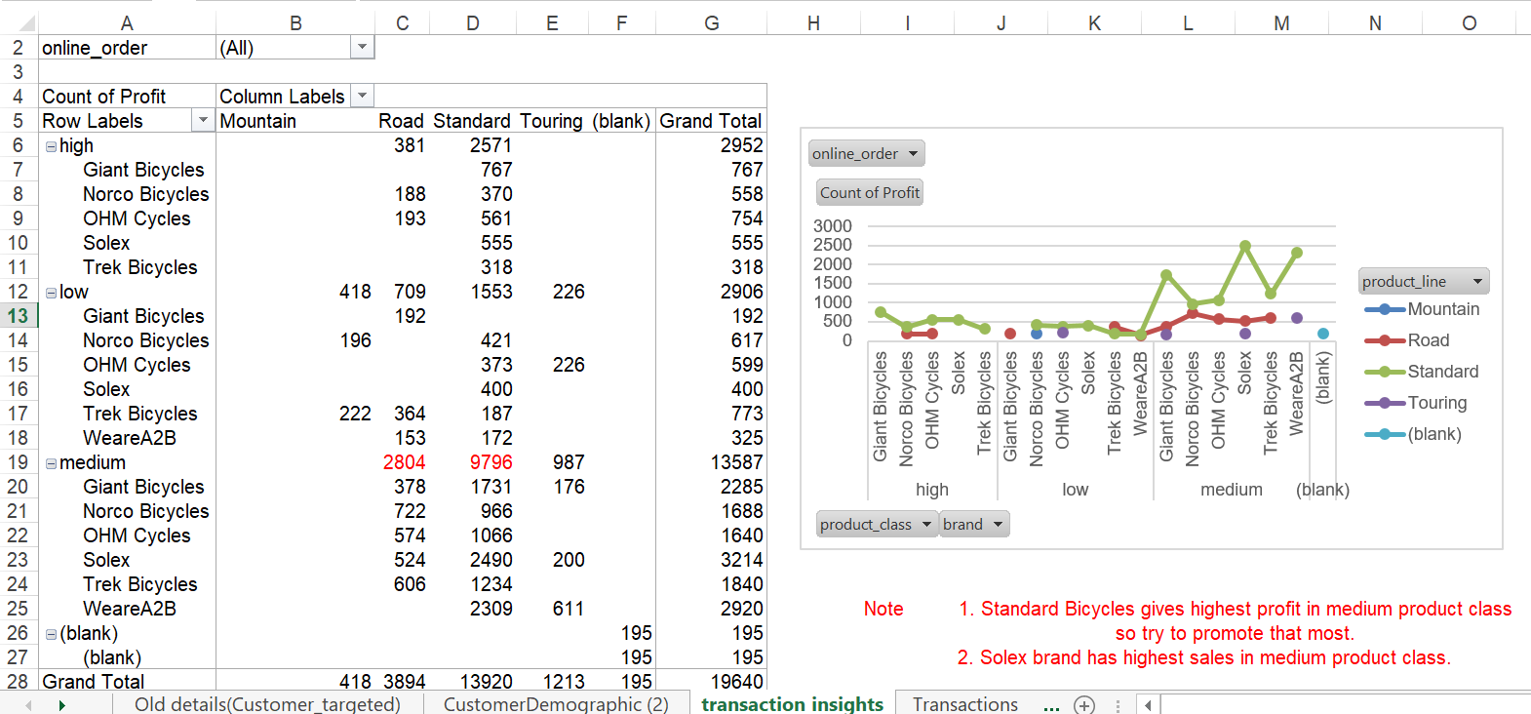
Data Exploration
Customer Analysis
Age Distribution analysis
Job Industry category analysis
Top model analysis
Wealth segment analysis
Profit analysis
Gender Distribution
Place any supporting images, graphs, data or extra text here.

Slide 8
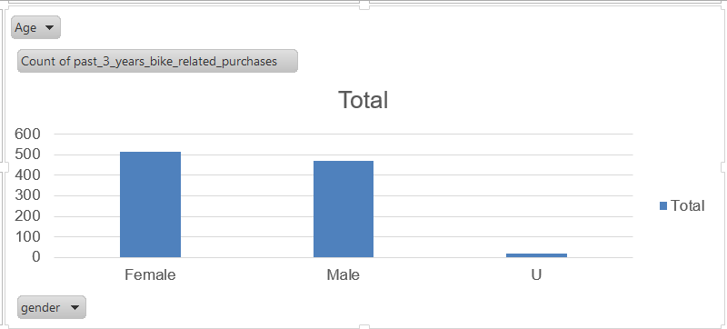
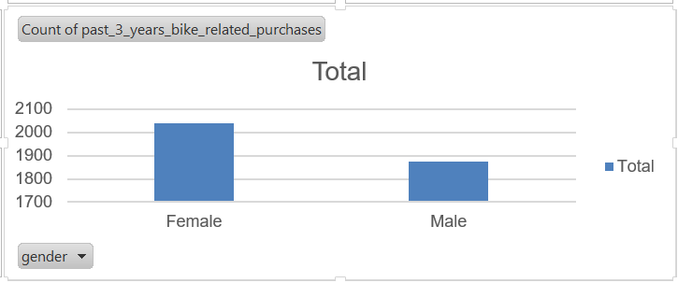
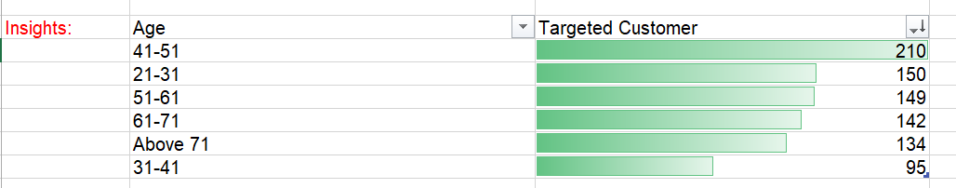
Data Exploration
New Customer
Customers Age distribution
1. According to new customer data we have to focus mostly on the customer females whose age is 41-51 and males whose age is between 21-31.
2. If you want more customers then target females whose age between 51-71.
3. According to old customers Females are more than males
Old Customer

Slide 9
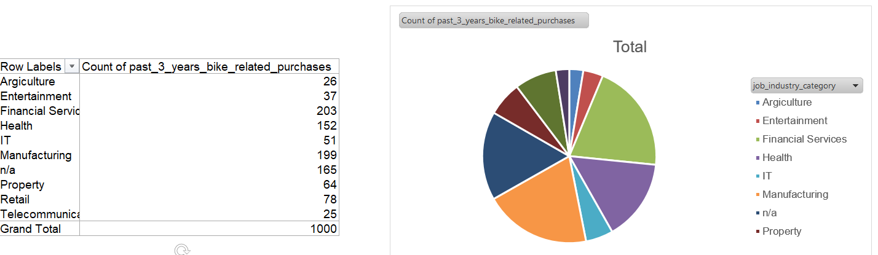
Data Exploration
Job Industry category analysis
Note: Financial Service, Manufacturing, and Health Customers are more so focus on that one

Slide 10
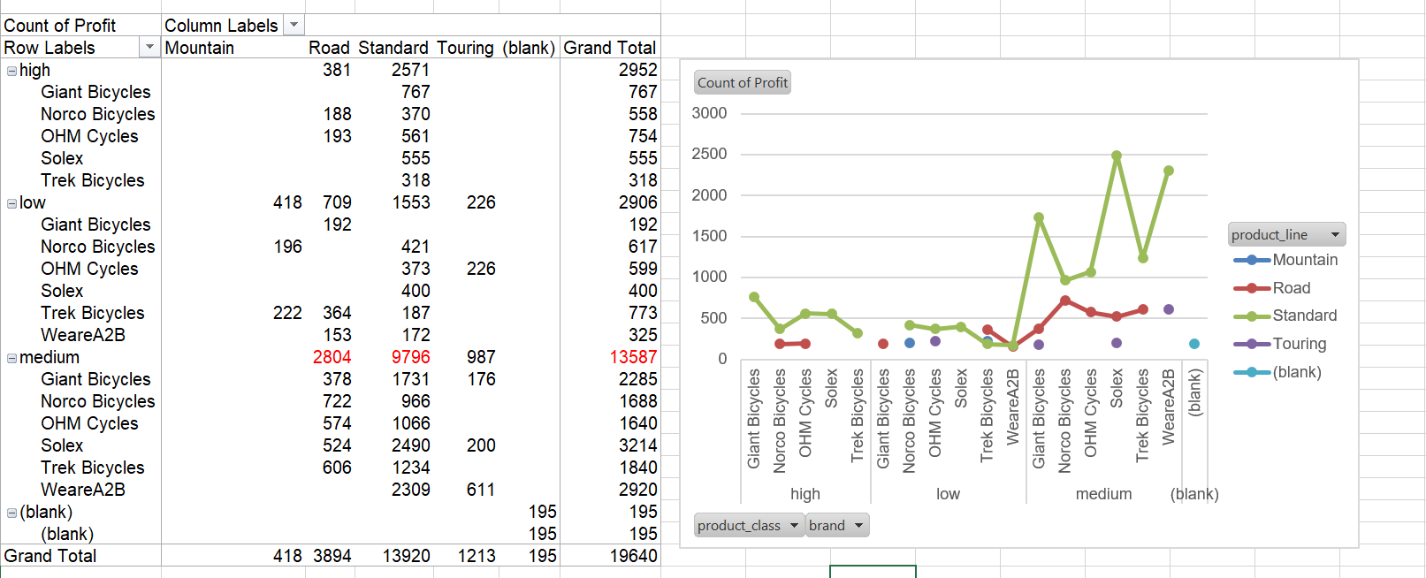
Data Exploration
Top bike model analysis
1. Standard Bicycles gives highest profit(9796) in medium product class so try to promote that most after that promote Road product line.
2. Solex brand has highest sales in medium product class.

Slide 11
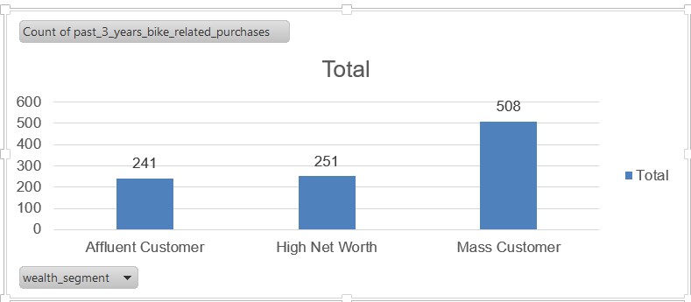
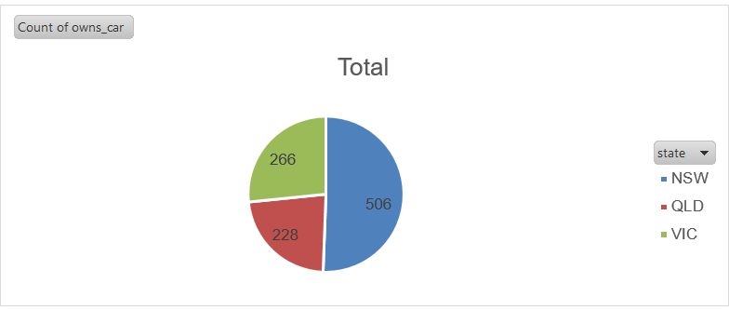
Model Development
Bike purchases last 3 years analysis
As we can see, our new customers mostly Female with 51.30% purchases and Male contributed to 47% purchases. So, we should focus on advertises on Female customers than Male customers.
Focus on Mass customer more.
Focus on QLD and VIC state more because they don’t own cars so high chance they will purchase bikes.

Slide 12
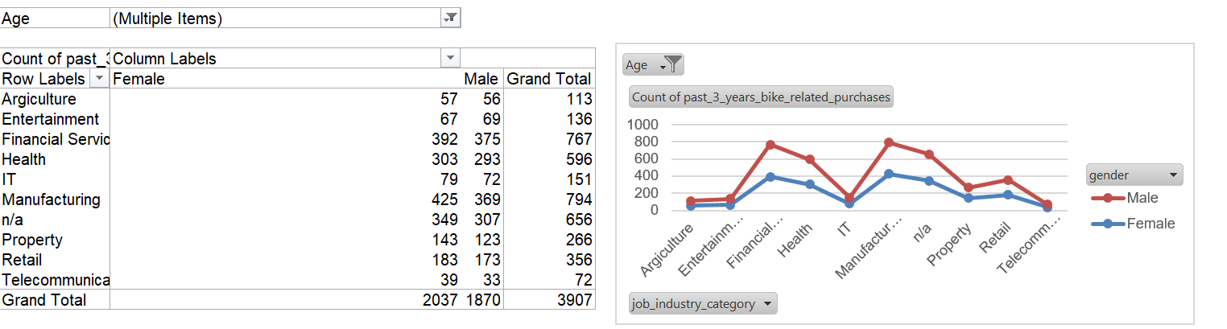
Interpretation
Job Industry category analysis
Mostly our new customers are on Finance industries, Manufacturing and Health are still on top3.
The rest industries is still same.

Slide 13
Data Insight Conclusion
Top targeted customer
New Customer insights-
Focus on females whose age is 41-61 and males whose age is between 21-31.
Focus on mass customer followed by High Net Worth
Focus on QLD and VIC state more because they don’t own cars so high chance they will purchase bikes.
Financial Service, Manufacturing, and Health Customers are more so focus on that one
Customer Demographic insights-
According to previous data Manufacturing, Financial Service and Health Customers
are more
Mass customer are 51 % means almost half so focus more on this wealth
segment customers .
Female customers are more in each field according to previous data
Transaction insights-
Standard Bicycles gives highest profit in medium product class so try to
promote that most.
Solex brand has highest sales in medium product class.
Top 1000 customers
New customer |  | 61
old customer |  | 416
Top customer who gives you highest profit |  | 588

Slide 14
Problem 3 Solution

Slide 15
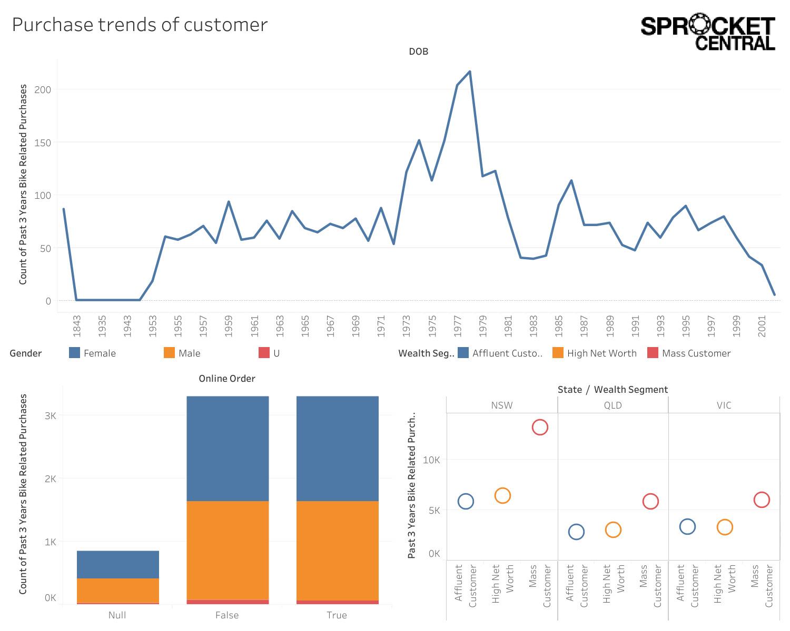
Purchase trends of customer
According to Age Distribution analysis 1978 DOB customer purchase highest bikes.
In NSW state mass customer Wealth segment purchase highest.
Females purchase more than males.
Place any supporting images, graphs, data or extra text here.

Slide 16
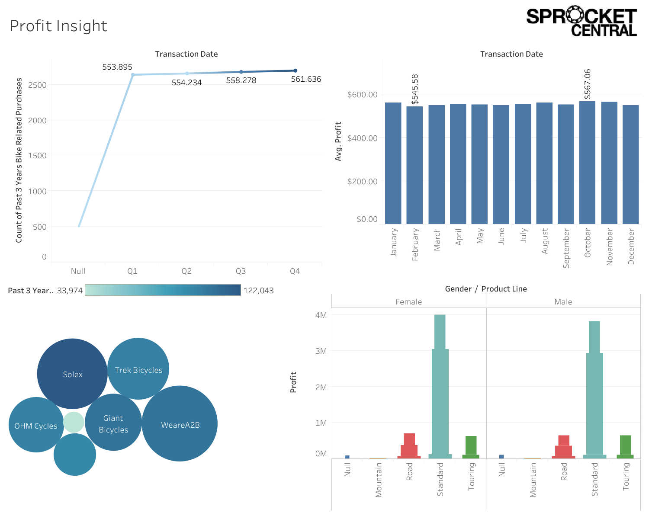
Profit Insight
New Customer
1 In Quarter 4 we got highest purchase and profit too.
2. In Feb minimum profit we got 545.58$ and in Oct we got highest profit 567.06$.
3. Highest purchase brand was Solex and highest profit given by WeareA2B.
4. Highest profit by female, medium product size bike and standard product line.
Old Customer

Slide 17
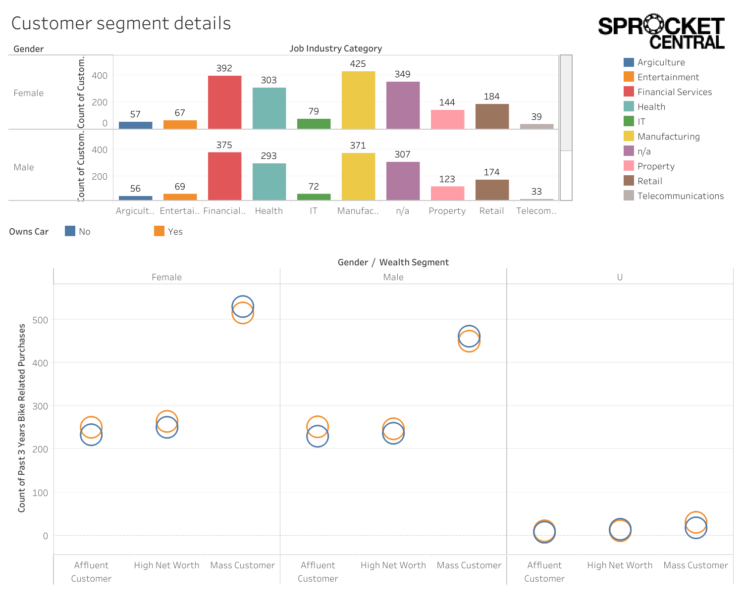
Customer Segment Details
Highest customers from
Financial Service- 392 females and 375 males
Manufacturing- 425 females and 371 males
Mass customer Females are more in number as compare to others.

Slide 18
Dashboard Conclusion
Purchase trends of customer-
According to Age Distribution analysis 1978 DOB customer purchase highest bikes.
In NSW state mass customer Wealth segment purchase highest.
Females purchase more than males.
Profit Insight-
In Quarter 4 we got highest purchase and profit too.
In Feb minimum profit we got 545.58$ and in Oct we got highest profit 567.06$.
Highest purchase brand was Solex and highest profit given by WeareA2B.
Highest profit by female, medium product size bike and standard product line.
Customer Segment Details-
Highest customers from
Financial Service- 392 females and 375 males
Manufacturing- 425 females and 371 males
Mass customer Females are more in number as compare to others.

Slide 19
Thank You!
- Khushi Yadav
14-04-2023

